Slide 1
Cardiovascular System
Session 5
Factors affecting flow through tubes

Slide 2
Aims of this session:
To understand the factors influencing the flow of fluids through tubes
To understand the concepts of flow, resistance and pressure
To understand the special factors affecting the flow of blood through blood vessels
To understand how resistance reveals control blood flow to individual tissue
To appreciate the range of factors affecting resistance vessels

Slide 3
Learning outcomes :
By the end of this session and with appropriate self study you should be able to:
Define the terms 'flow' and 'velocity' with respect to the movement of fluids through tubesand state the relationship between them
Describe what is meant by 'laminar' and 'turbulent' flow
Describe what is meant by viscosity, and the effect of viscosity upon flow
Describe the effects of changes in tube diameter on flow rate
Define the term 'resistance' to flow and state the factors which affect flow resistance
Describe the relationship between pressure, resistance and flow
Describe the effects of combining flow resistances in series and in parallel
Describe the pattern of flow resistance and pressure over the systematic circulation

Slide 4
Describe how the distensibility of blood vessels affects the relationship between flow and pressure
Describe how distensibility of blood vessels produces the property of capacitance

Slide 5
In order to understand how blood flows through blood vessels we must first consider the physics of how fluids flow through rigid tubes.
First, definitions:
Flow:
Velocity:
If flow rate is constant then velocity varies inversely with the cross-sectional area of the tube.
This applies whether flow is through a single tube or a set of parallel tubes.

Slide 6
Example:
The flow through the systemic circulation is the same at each level - the arteries, arterioles,capillaries and veins. Why is the velocity 500 mm.s-1 in the aorta, but only 0.1 mm.s-1 in the capillaries, when 5 l.min-1 flows through both?
Flow along tubes is driven by a difference of pressure between one end of the tube and the other ('pressure gradient'). If all else remains the same what will happen to flow if the pressure gradient increases?

Slide 7
There are two ways in which fluid flows through tubes - Laminar and Turbulent.
Laminar Flow :
Turbulent Flow:
Mostly, flow in the circulation is laminar. Turbulent flow generates sound. In laminar flow adjacent layers of fluid are moving along the tube at different velocities, and so must slide over one another. The extent to which they can do this is determined by the viscosity. In more viscous fluids the layers are harder to separate.

Slide 8
So for a given pressure gradient and a given tube what will happen to the average velocity of flow if the viscosity of the fluid increases?
As the velocity at the wall is zero, the wider the tube, the more velocity can increase towards the middle of the tube as successive layers slide relative to one another. Average velocity, all other things being equal, therefore increases as the surface area (proportional to radius 2) ofthe tube.

Slide 9
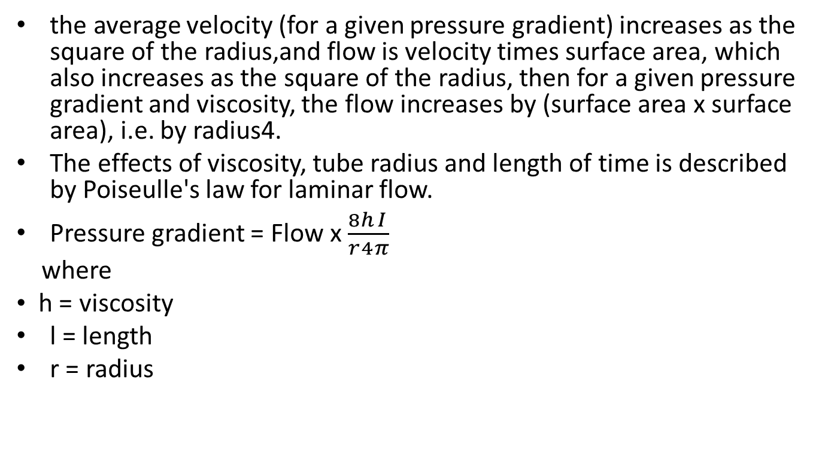
the average velocity (for a given pressure gradient) increases as the square of the radius,and flow is velocity times surface area, which also increases as the square of the radius, then for a given pressure gradient and viscosity, the flow increases by (surface area x surface area), i.e. by radius4.
The effects of viscosity, tube radius and length of time is described by Poiseulle's law for laminar flow.
Pressure gradient = Flow x $\frac{8}{r}\frac{h}{4}\frac{I}{π}$
where
• h = viscosity
l = length
r = radius

Slide 10
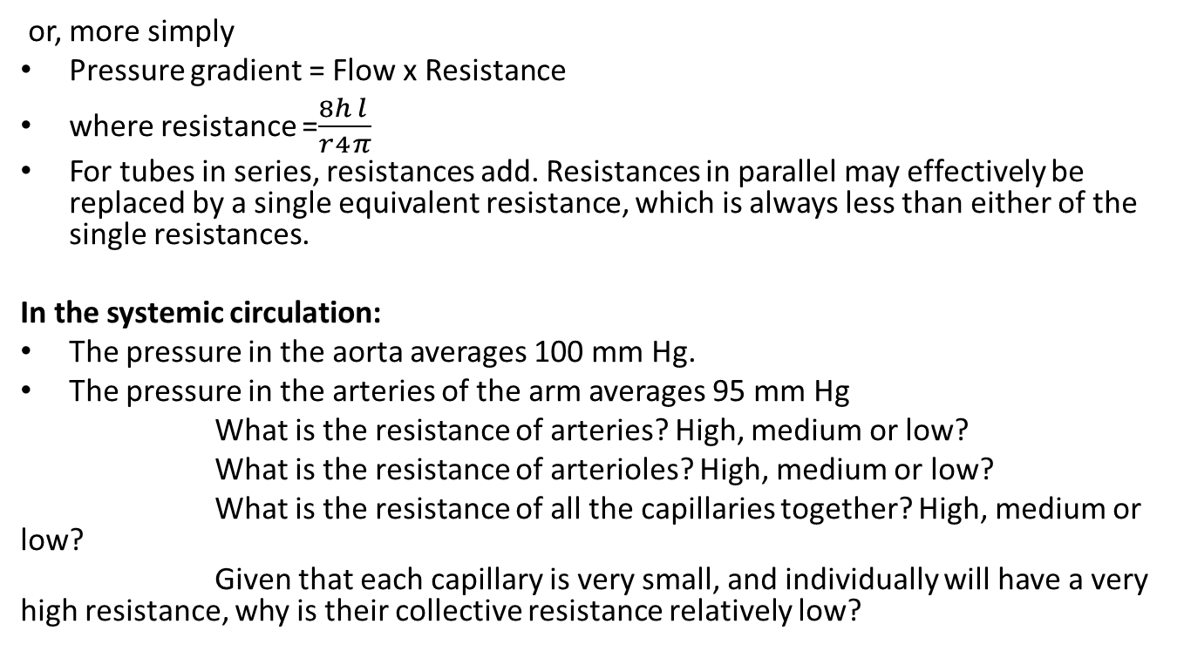
or, more simply
Pressure gradient = Flow x Resistance
where resistance =$\frac{8}{r}\frac{h}{4}\frac{l}{π}$
For tubes in series, resistances add. Resistances in parallel may effectively be replaced by a single equivalent resistance, which is always less than either of the single resistances.
In the systemic circulation:
The pressure in the aorta averages 100 mm Hg.
The pressure in the arteries of the arm averages 95 mm Hg
What is the resistance of arteries? High, medium or low?
What is the resistance of arterioles? High, medium or low?
What is the resistance of all the capillaries together? High, medium or low?
Given that each capillary is very small, and individually will have a very high resistance, why is their collective resistance relatively low?

Slide 11
Special properties of blood vessels
Blood vessels are not rigid pipes, their walls can stretch - they are 'distensible'. The force tending to stretch the walls, and so increase the radius is the pressure difference between the inside and outside of the tube - the transmural pressure. As pressure increases so the wallsstretch and resistance falls. Draw the relationship between pressure and flow in this case.
Blood vessels close completely at supply pressures above zero. As pressure rises, so flow increases dramatically, because the vessels distend.
If pressure changes suddenly, more blood will flow into than out of the tube as it distends.
Distensible tubes can therefore, in effect, 'store' blood - they have capacitance.
The walls of many blood vessels also contain smooth muscle. If this changes its state of contraction, then the diameter of the vessel and will change as the relationship between pressure and flow is altered.

Slide 12
Draw the change in the relationship between pressure and flow if the muscle contracts more.

Slide 13
What effect will such vasoconstriction have on resistance?
What will happen to resistance if the muscle contracts less - vasodilatation?

Slide 14
Thanks for your attention

